Slide 1
iOS APPLICATION DEVELOPMENT
COMPANY NAME: CALIBRE CODE SOLUTIONS PVT LTD
CEO AND FOUNDER: MRS. SEEMA NAIR
UNDER THE GUIDANCE:
Dr.Mohideen S Bhadusha
SENIOR PROFESSOR
PRESENTED BY:
Jyothi Lakshmi
4AL16CS129
VIII sem “B”

Slide 2
CONTENTS:
Company Introduction
Internship Objective
Introduction to Swift
Modules
Project Screenshots
Results
Conclusion
References

Slide 3
CALIBRE CODE SOLUTIONS PVT LTD.
Calibre Code Solutions Pvt Ltd was founded in 2017 .
Company objective: To be an innovative, cost-effective and reliable testing partner for companies and products that require QA services.
CEO and Founder: Mrs. Seema Nair .
She oversees project execution and client communications at CalibreCode.
CalibreCode’s wide domain knowledge, adherence of best practices and team of qualified engineers provides comprehensive testing coverage at all phases of a project.

Slide 4
INTERNSHIP OBJECTIVE
Objective of the Internship:
To learn iOS application development using Swift language
To develop iOS application by using Swift Language
Launch the Developed Application in The App Store

Slide 5
INTRODUCTION SWIFT & XCODE
Swift is a powerful and intuitive programming language for macOS, iOS, watchOS, tvOS and beyond. Writing Swift code is interactive and fun, the syntax is concise .
Swift code is safe by design, yet also produces software that runs lightning-fast
Var myString = “Hello, World!”
Print(myString)

Slide 6
Swift eliminates entire classes of unsafe code.
Variables are always initialized before use, arrays and integers are checked for overflow, memory is automatically managed.
for example, simple three-character keywords define a variable ( var ) or constant ( let ).
Another safety feature is that by default Swift objects can never be nil.

Slide 7
Swift was built to be fast.
Using the incredibly high-performance LLVM compiler technology, Swift code is transformed into optimized native code that gets the most out of modern hardware.
LLVM compiler can be used to develop a front end for any programming language.
Data Types of Swift:
Int
Float
Double
Bool
String

Slide 8
FUNCTION DEFINITION:
In Swift , a function is defined by the "func" keyword
Syntax
Func funcname(Parameters) -> returntype {
Statement1
Statement2
-------------
Statement N
return parameters
}

Slide 9
Example:
Func student(name: String) -> String {
return name
}
print(student(name: “First Program”))
print(student(name: “About Function”))
Output
First Program
About Functions

Slide 10
Xcode 9 includes everything you need to create amazing apps and to bring your apps to even more devices.
Take advantage of SwiftUI, an all-new user interface framework with a declarative Swift syntax.
SwiftUI is an innovative, exceptionally simple way to build user interfaces across all Apple platforms with the power of Swift.
Build user interfaces for any Apple device using just one set of tools and APIs.

Slide 11
UIKit
Construct and manage a graphical, event-driven user interface for your iOS or tvOS app.
It provides the window and view architecture for implementing your interface, the event handling infrastructure for delivering Multi-Touch and other types of input to your app.
Every UIKit app is required to have the following resources:
App icons
Launch screen storyboard

Slide 12
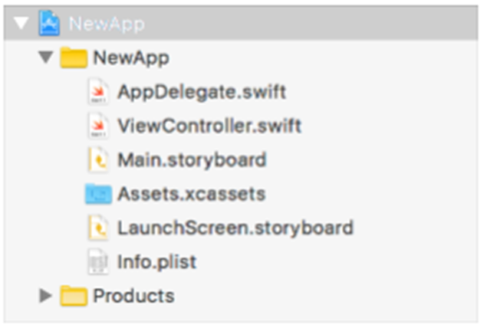
The structure of a single view iOS app

Slide 13


PROJECT SCREENSHOTS:
APP Logo
Launch Screen

Slide 14
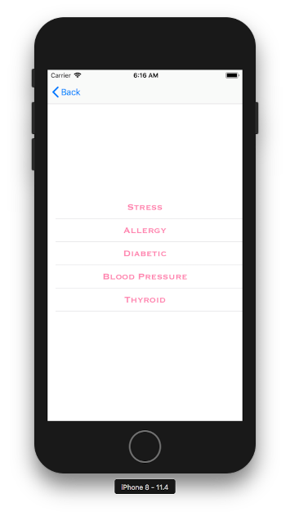

Main Screen
List Screen

Slide 15
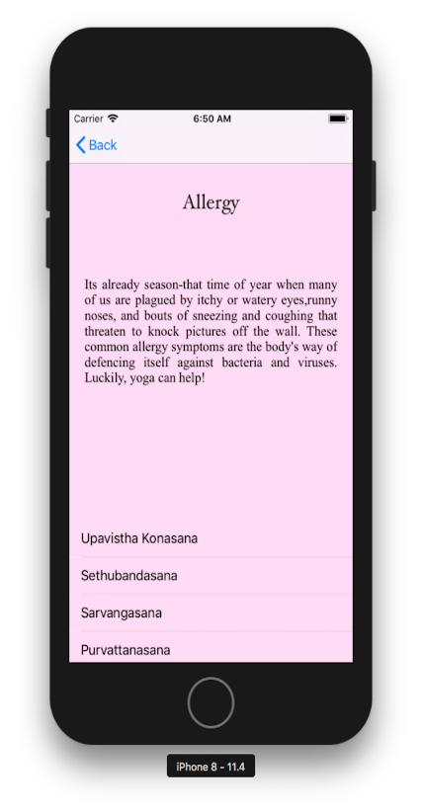
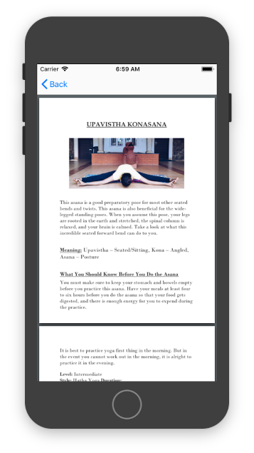
Description Screen
Information Screen

Slide 16
SKILLS LEARNT:
Working on XCode Platform
Swift Programming
Coding Logic
Designing of UI

Slide 17
Results:
The “YogaStation” IOS Application is very nicely designed yoga app for beginners to practice at home and make choice accordingly related to Stress, Diabetes, Blood Pressure, Thyroid, and Allergy.
The application was successfully Launched in IOS app store

Slide 18
CONCLUSION
Worked in a team of three and successfully completed the project.
Obtained an experience in developing iOS application for iPhone.
Able to navigate the Xcode as well as program in Swift 3
Developed a application and deployed it on the App Store

Slide 19
References
https://swift.org/documentation/
https://developer.apple.com/documentation/uikit/about_app_development_with_uikit

Slide 20
THANK YOU

